Slide 1
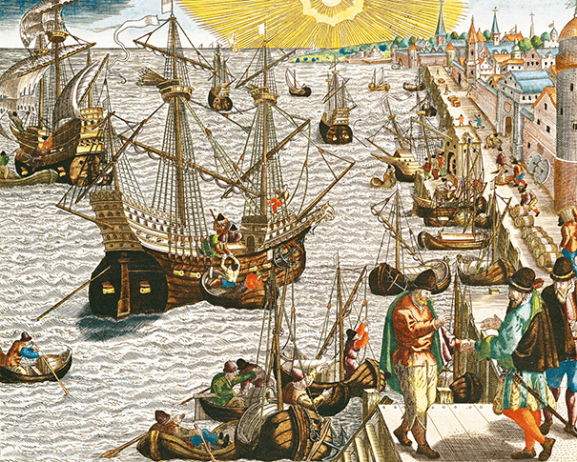
New Global Connections (1415-1796)
Topic 5 Lesson 6 Effects of Global Contact

Slide 2
New Global Connections (1415-1796)
Topic 5 Lesson 6 Effects of Global Contact
Key Terms
Columbian Exchange.
Commercial Revolution,
inflation.
price revolution.
capitalism,
free enterprise system,
entrepreneurs,
mercantilism,
tariffs,

Slide 3
New Global Connections (1415-1796)
Topic 5 Lesson 6 Effects of Global Contact
Learning Objectives
Explain how European exploration led to the Columbian Exchange.
Explain new economic factors and principles that contributed to the success of the commercial revolution.
Understand the impact of mercantilism on European and colonial economies.

Slide 4
The Columbian Exchange
A Global Exchange
This will begin with Columbus bringing plants and animals to Spain and when he returns to the Americas he will bring European plants and animals
Exchanging Foods and Animals
Europeans will find tomatoes, pumpkins, peppers, potatoes, and corn in America that is new to them
Americans will find out about wheat, grapes, bananas, sugar cane, cattle, pigs, goats, chickens, and horses
Population Growth
All of these new foods will contribute to population growth around the world
Movement of People and Ideas
Vast movement of people will bring the transfer of new ideas and technology. Language will change, and people will bring home ideas and inventions from distant lands

Slide 5
The Columbian Exchange
This 1592 engraving shows ships preparing to leave Lisbon, Portugal, bound for Asia and the Americas.

Slide 6
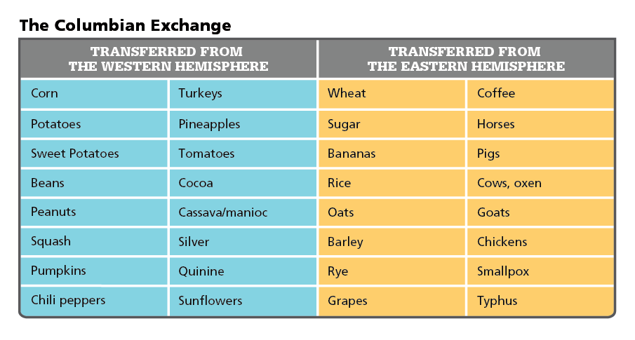
The Columbian Exchange
Analyze Charts The Columbian Exchange affected people around the world. What livestock were introduced to the Americas by the Columbian Exchange?

Slide 7
A Commercial Revolution
The Price Revolution
By the 1500’s prices are beginning to rise in Europe. There is also more money in circulation. The rise in price linked to a sharp increase in money available is called inflation. This is the Price Revolution and it happens because of the amount of gold and silver entering from the America’s in the mid 1500’s
Free Enterprise
Capitalism- the investment of money to make a profit
Capitalist economy most businesses are privately owned and economic decisions are based on supply and demand
This is going to start the Commercial Revolution
Entrepreneurs are going to start businesses, hire people, buy resources, push for laws to protect their investments, and take risks with their ventures. They will expand into overseas markets and take the risks involved.
Supply and demand will begin to control markets and prices

Slide 8
A Commercial Revolution
New Business Methods
European capitalist will learn from the Arabs methods of bookkeeping that will show them profits and losses from their business ventures
The joint stock company will allow people to pool large amounts of money for an overseas trading voyage. If the voyage made a profit then the person took a percentage of the profit. If the venture failed investors only lost the money they put in
Entrepreneurs Bypass the Guilds
The growing demand for goods will lead merchants to find ways to increase production. Guilds control the manufacture of goods. Guilds however had small scale enterprises not good for large markets
This will force merchants to bypass guilds, and eventually leading to capitalist owned factories in the Industrial Revolution

Slide 9
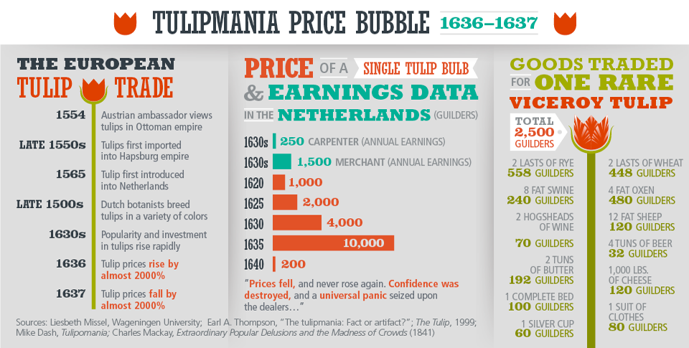
A Commercial Revolution
Analyze Charts Tulipmania is an example of an inflationary price bubble. From an investment standpoint, which year was the worst to buy a tulip? Explain.

Slide 10
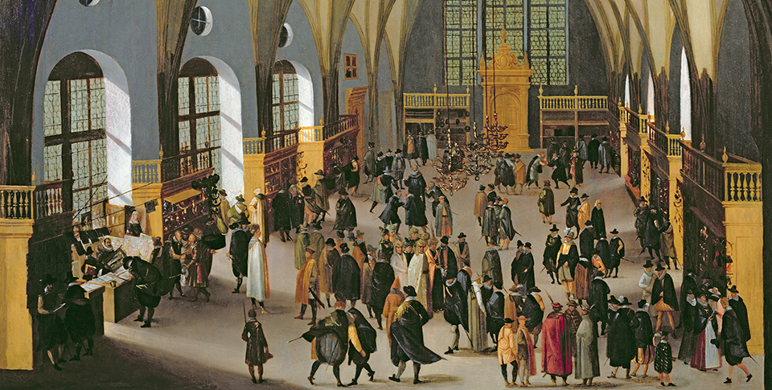
A Commercial Revolution
During the Commercial Revolution, the Prague stock exchange was a busy center of investment activity. Prague was the capital of the Holy Roman Empire in the late 1500s.

Slide 11
Mercantilism
The Value of Colonies
Mercantilist viewed colonies to exist only to benefit the parent country. Colonies provided raw materials not available in Europe, were the markets for the parent country for their goods.
Parent countries passed strict laws regulating trade, colonies could not manufacture goods, and could not buy goods from other countries
Increasing National Wealth
Countries took measure that they believed would increase national wealth and government revenues
They created and increased infrastructure, backed new industries, made national currencies, and established a standard weight and measurement system.
Governments will sell monopolies to large producers and overseas trading companies and establish tariffs on imported goods.

Slide 12
Mercantilism
Impact on European Society
By the 1700’s European societies are still divided into distinct social classes. Merchants who invest overseas are wealthy while the price revolution hurts the nobles whose wealth was in land.
Skilled workers and merchants in cities are thriving
Hired laborers and servants of upper and middle class people however live in crowded quarters on the edge of poverty

Slide 13
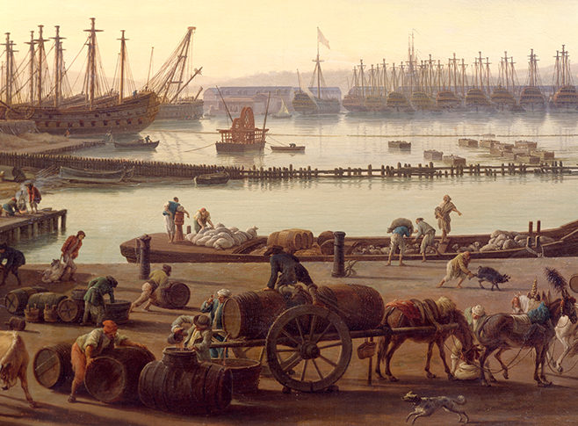
Mercantilism
As European rulers embraced mercantilism and expanded trade, their ports became thriving centers of commerce. This painting depicts the crowded port of Toulon, France, in the mid-1700s.

Slide 14
Quiz: The Columbian Exchange
Which of the following was an effect of the Columbian Exchange on population?
A. Millions of people moved to the Americas.
B. Exchanges of food plants decreased populations in various regions.
C. Some populations thrived as they developed resistance to new diseases.
D. Millions of people moved to Europe.

Slide 15
Quiz: A Commercial Revolution
Which of the following was a difference between capitalist entrepreneurs and guild masters?
A. Guild masters hired many more workers than capitalists.
B. Capitalists let supply and demand set prices; guild masters regulated prices.
C. Guild masters invested their profits in global businesses; capitalists gave their profits to cottagers.
D. Capitalists were reluctant to compete and take risks; guild masters were eager to expand into risky overseas markets.

Slide 16
Quiz: Mercantilism
According to the economic policy of mercantilism, how did colonies benefit the parent European country?
A. Colonies sent raw materials to the parent country and bought the parent country’s manufactured goods.
B. Colonies sent manufactured goods to the parent country and bought the parent country’s raw materials.
C. Colonies sent immigrants and cultural items to the parent country.
D. Parent countries sent industry and profits to the colonies.

